Slide 1
Automating Article Segmentation
A summer research project by Nicole Chan
Supervised by David Bainbridge

Slide 2
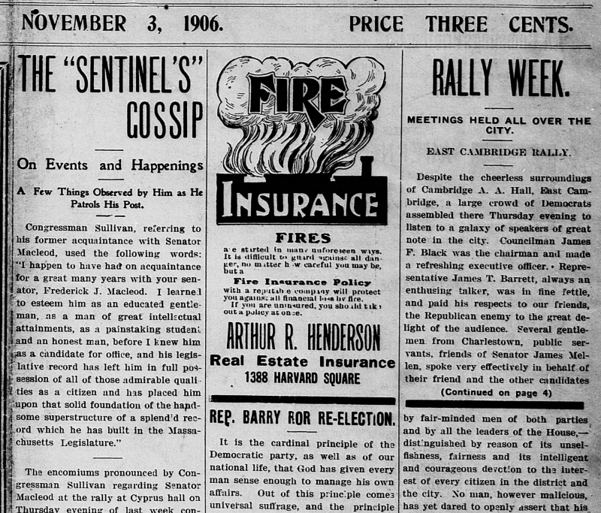
Defining the project
Make a test bed:
Define an input
Machine Learning Magic!
Define an output
What is article segmentation?
How can we automate this?!

Slide 3
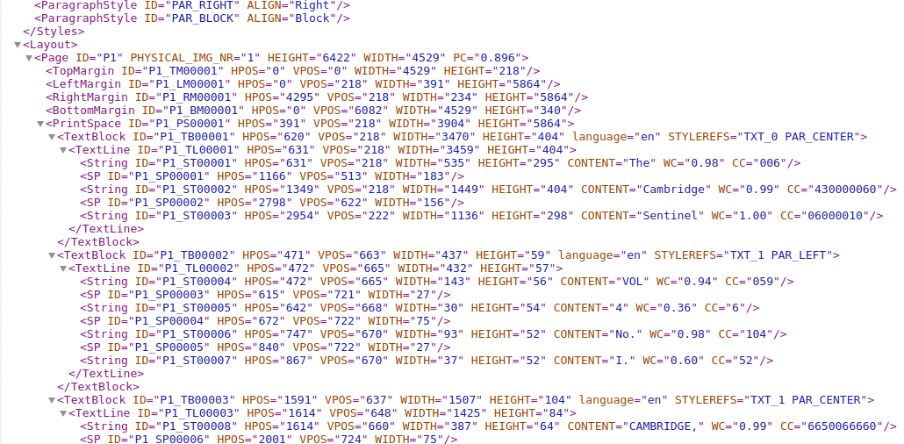
What is METS/ALTO
ALTO
Page>Print Space>Text Block>Text Line>String

Slide 4
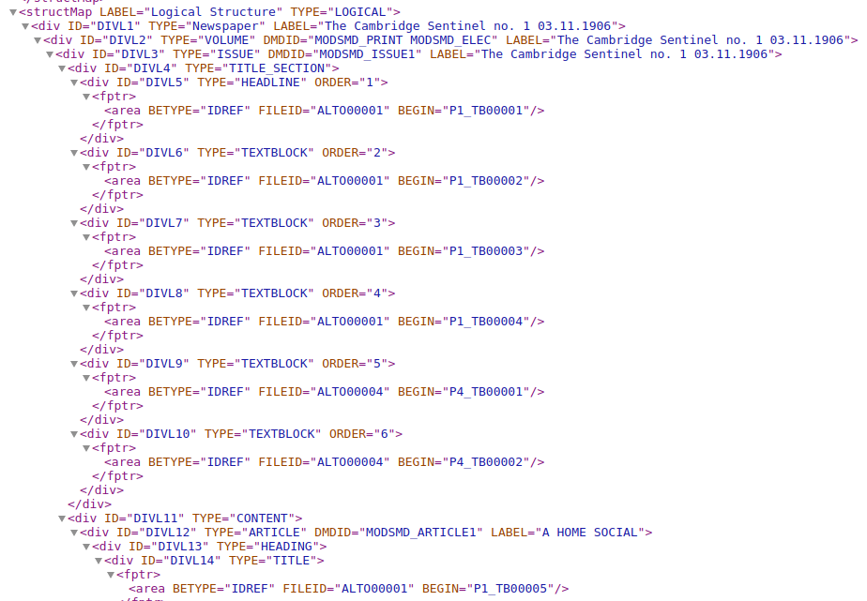
What is METS/ALTO (2)
METS
“Branches” of text blocks

Slide 5
Initial Approach
Interest in Natural Language Processing (NLP)
Parts of Speech Identification (POS)
Sentence Boundary Identification
Topic Shifting

Slide 6
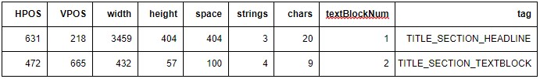
New approach: Formatting
9 different parameters:
Horizontal position,
Vertical position,
Width,
Height,
Space,
Number of strings,
Number of characters,
Text block number
Tag

Slide 7
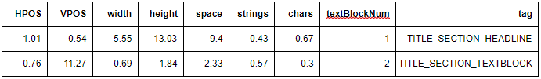
Formatting (2)
Normalised Values

Slide 8

WEKA!
Data Mining with WEKA
Clustering
Classification
https://en.wikipedia.org/wiki/Weka_(machine_learning)

Slide 9
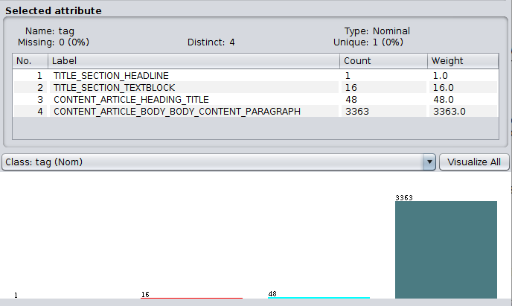
Unbalanced input Data

Slide 10
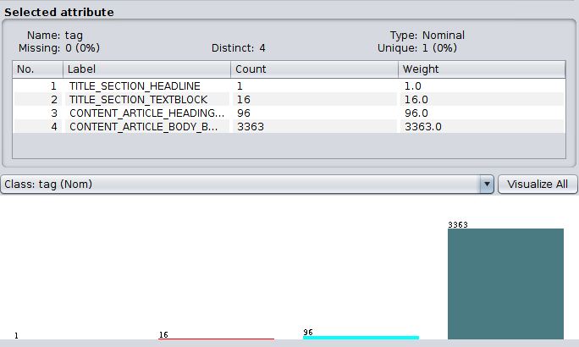
Smote filtering
Sentinel_19061103_0001.xml, a Class 3 filter of weight 100.0 was applied, which increased the weight of Class 3 - CONTENT_ARTICLE_HEADING_TITLE

Slide 11
Randomize FIlter
SMOTE groups “new data” – not ideal!

Slide 12
Auto-WEKA
J48 -> Random Forest!!
Hyperparameter tuning???

Slide 13
Cross-Validation
It then “hides” 10% of the data (due to it being a 10-fold cross-validation)
For the hidden 10%: it will have access to all the attributes of the lines, but not the tag column
For the other 90%: it will have access to all the attributes of the lines, including the tag column
It applies the filters to the other 90%, then creates a tree with how it got to its classification, and predicts the remaining 10%.
This process is repeated 10 times with a different section each time, hence why the randomization filter was needed!

Slide 14
Weka demonstration!

Slide 15
Discussion
More varied data
Comparing results better
Overfitting
Other algorithms!

Slide 16
Acknowledgements
David Bainbridge
Veridian – Jeffrey Ke and Stefan Boddie
Alvin Yeo

